Slide 1
ECOMMERCE DATA ANALYSIS AND VISUALIZATION
Presented by: Aniket Kolkar

Slide 2
Introduction to Problem statement
Datamatics Ltd is a UK based company.
This company sells unique all-occasion gifts and other items to customers.
Many customers of the company are wholesalers.
Provided data set contains all the transactions occurring between 01/12/2010 and 09/12/2011.
Goal:
1) Visualize the sales of this company
2) Know their annual sales and their customers
3) Provide important insights and recommendations to the company so they can improve their sale in next year

Slide 3
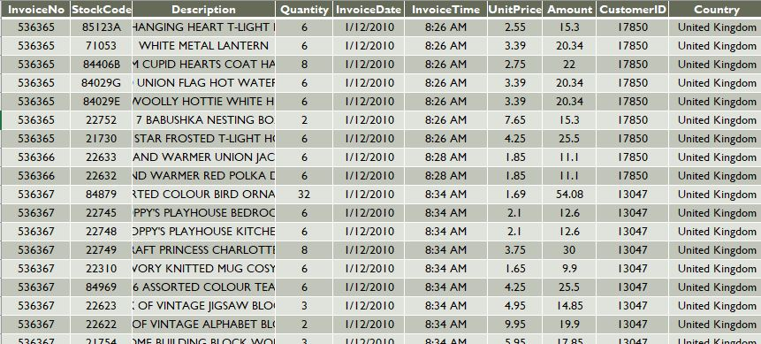
Dataset Preview
VariableName - Description
InvoiceNo: Unique ID to identify each Invoice
StockCode: Unique ID for each item in stock
Description: A short description for each item
Quantity: Number of items bought
UnitPrice: The price of each item
Customer ID: Unique ID for each customer
Country The country were the costumer live

Slide 4
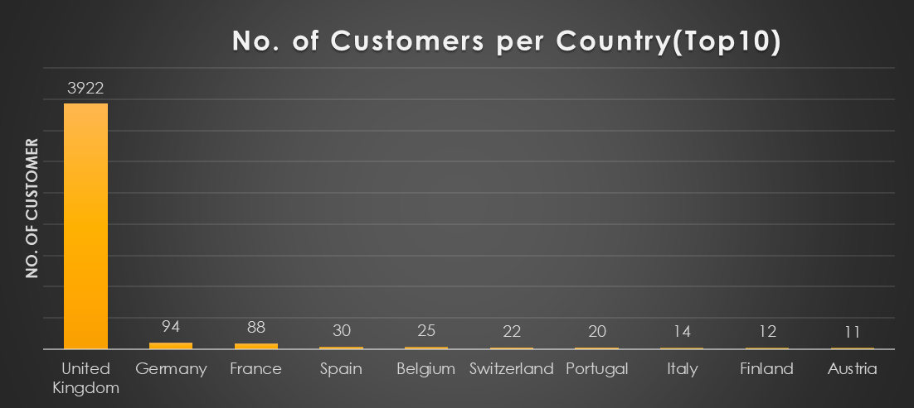
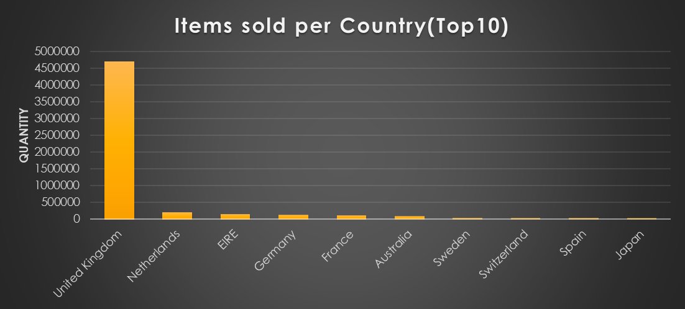
Total number of customers per country
Maximum customers are from UK
Followed by Germany, France, Spain etc.
Again maximum items sold in UK followed by Netherlands, EIRE, Germany etc.
Least items got sold in Saudi Arabia followed by Bahrain, RSA, Brazil.

Slide 5
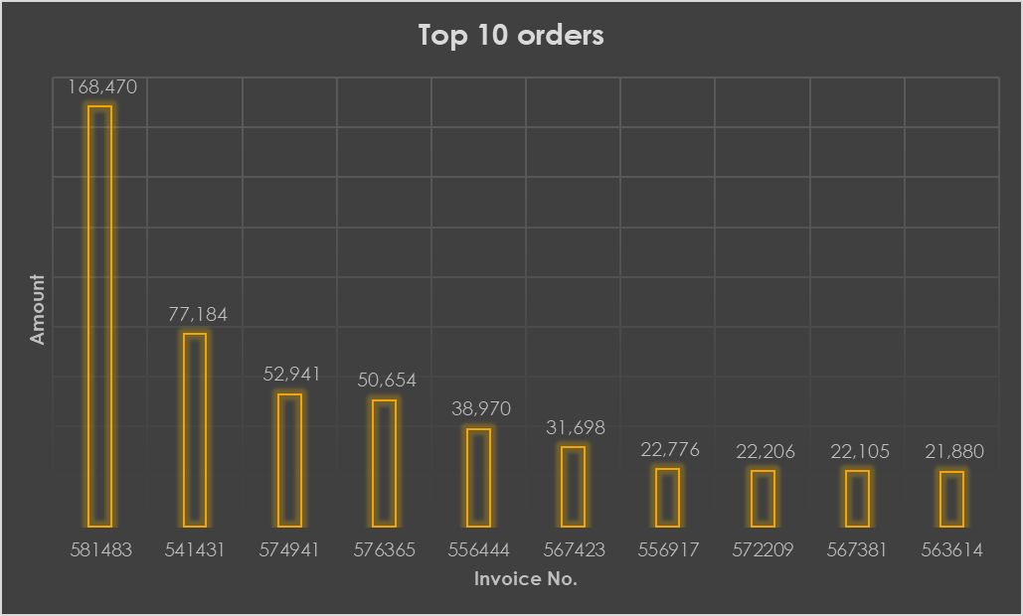
Top 10 orders of customers
This invoice no. belongs to top 10 orders
Y-axis represent sum of amount respective to invoice number.

Slide 6
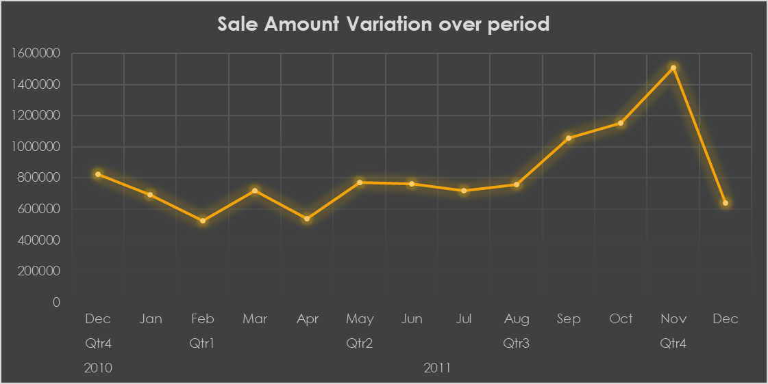
Sale amount is varying over 2 years
In quarter 4 of 2011, maximum sale occurred.
Sale in Dec-2010 is less than Feb-2011.
Remaining 3 quarter of 2011, sale remain nearly same.

Slide 7
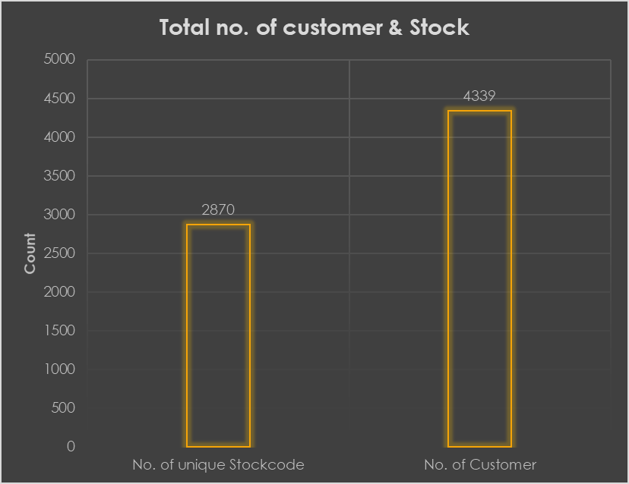
No. of unique stock item and customers
In dataset, total of 4339 customers are present
Unique stock items are 2870

Slide 8
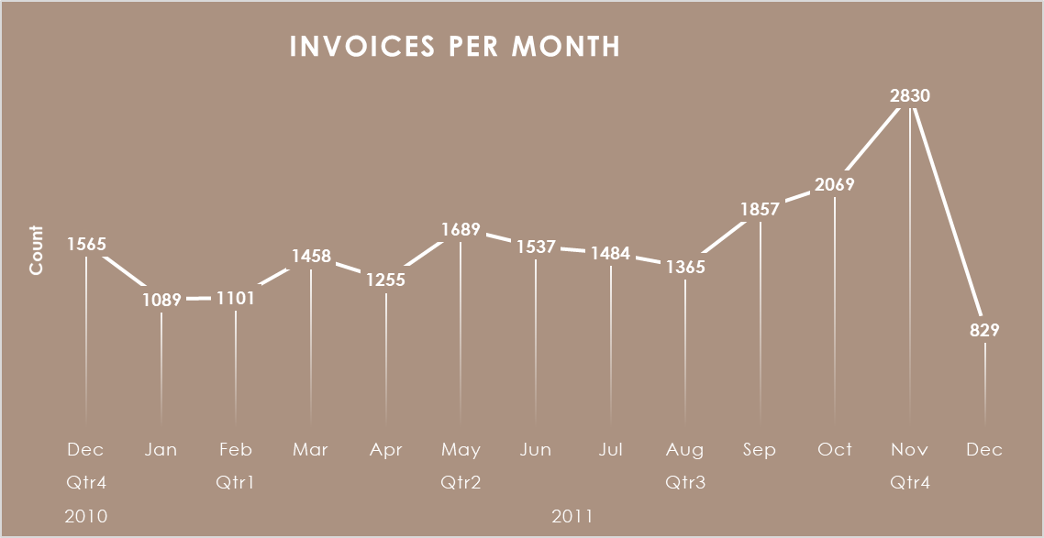
Invoices Distribution over months
In the month of Nov-2011, maximum invoices got issued
This followed by Oct-2011, Sep-2011
We don’t have complete data of Dec-2011, so invoices issued are less.

Slide 9
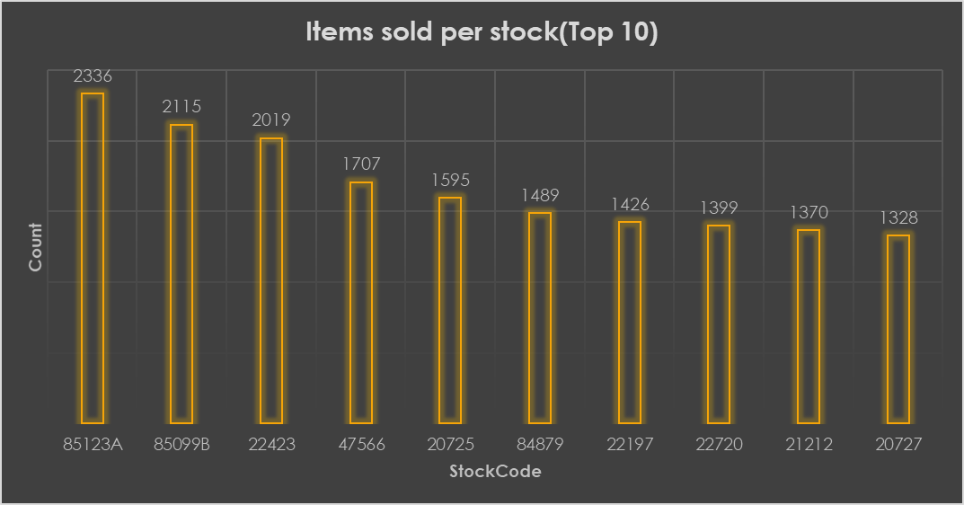
Stock items sold highest number
Items in these stockcode got sold in maximum number.

Slide 10
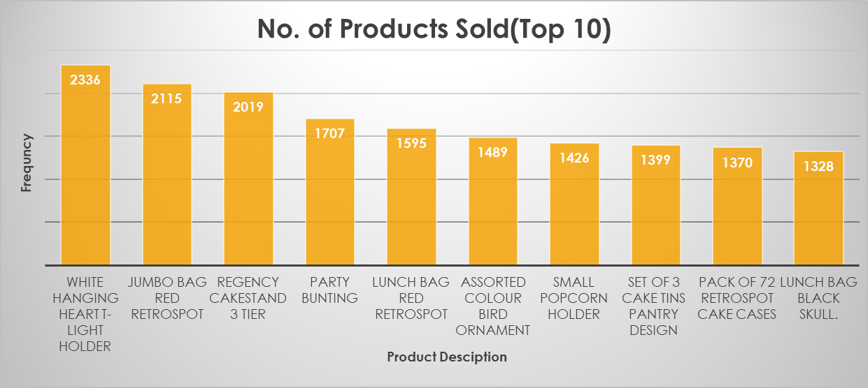
Most frequently purchased product
These product got purchased by customer very frequently
Taking it into consideration, company should make production of it in sufficient number

Slide 11
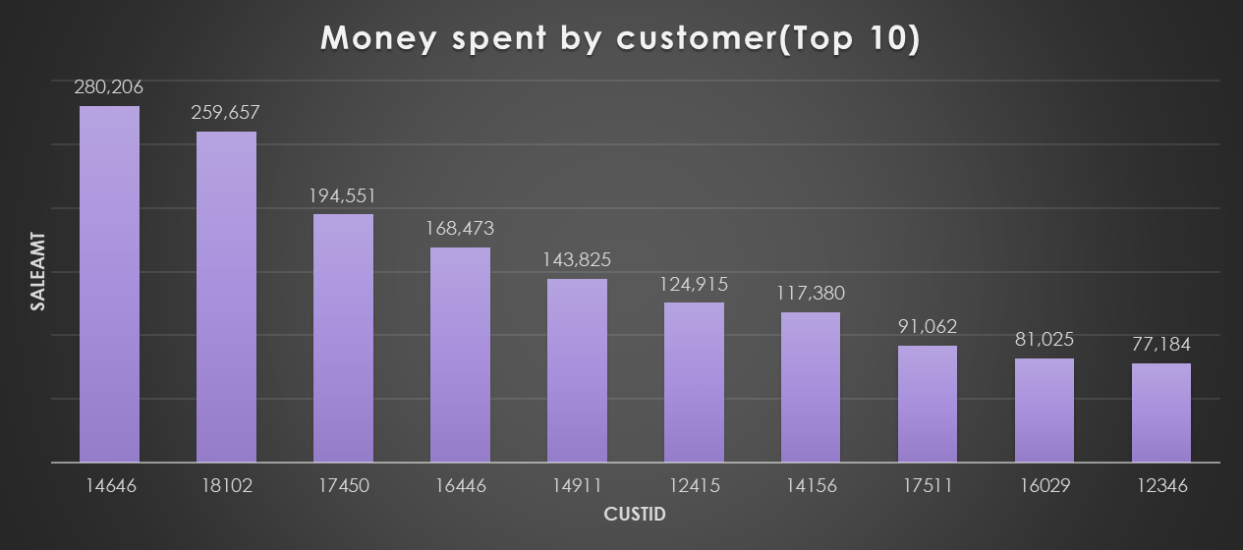
Money Spent by Customer
These CustomerID spent maximum money on buying items
Company should maintain good relationship with these customer

Slide 12
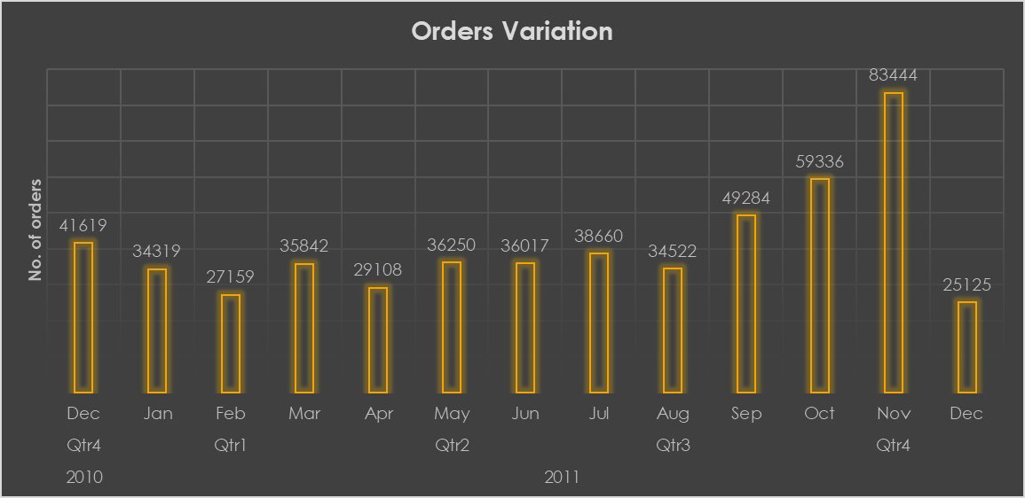
Order distribution over months
In quarter 4 of 2011, maximum orders placed due to festive season
Maximum order placed in Nov-2011
In reaming quarters, no. of orders remain same

Slide 13
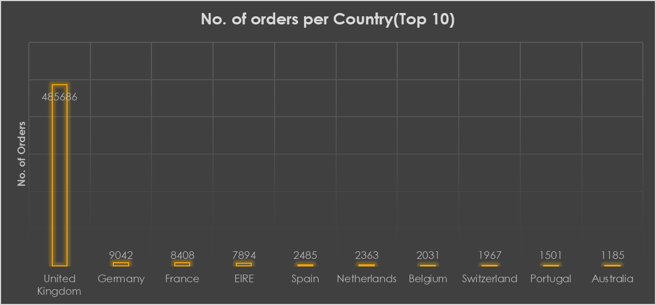
Orders Distribution per Country
Maximum orders are from UK
This is followed by Germany, France, EIRE etc.
Least orders are from Saudi Arabia, Bahrain, Czech Republic etc.

Slide 14
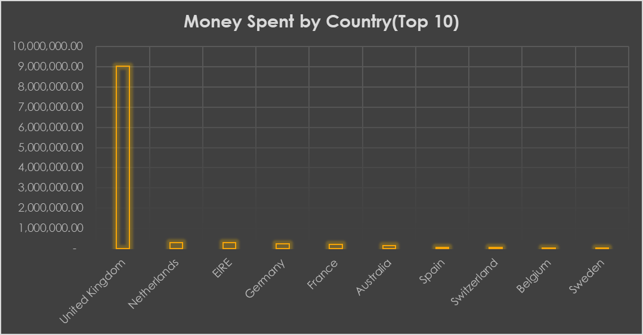
Money Spent by Country
In UK, maximum money spent to buy products from this company
Followed by Netherlands, EIRE, Germany etc.
Least money spent in Saudi Arabia, Bahrain, Czech Republic etc.

Slide 15
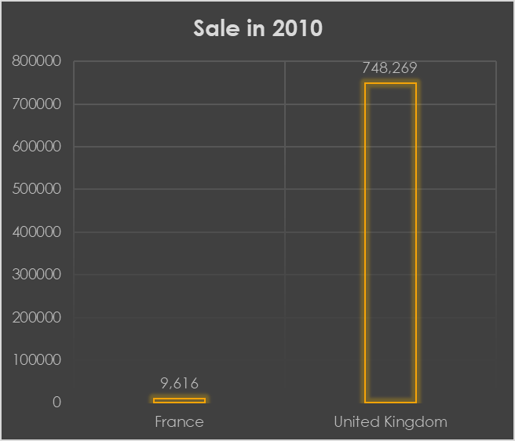
Total Sales of UK and France in 2010
These amount of total sale occurred in UK and France in the month of Dec-2010

Slide 16
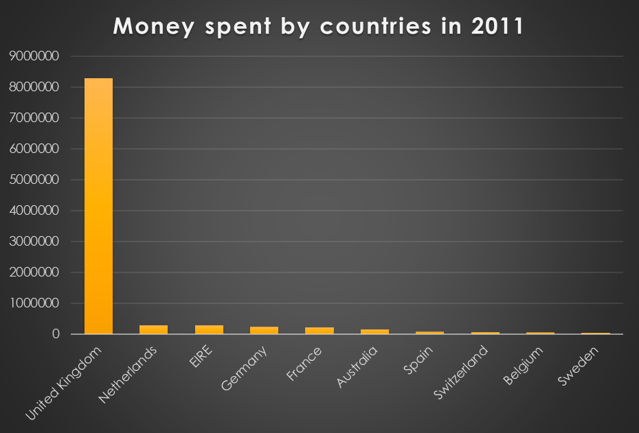
Money spent by countries in 2011
In UK, maximum money spent to buy products from this company
Followed by Netherlands, EIRE, Germany etc.

Slide 17
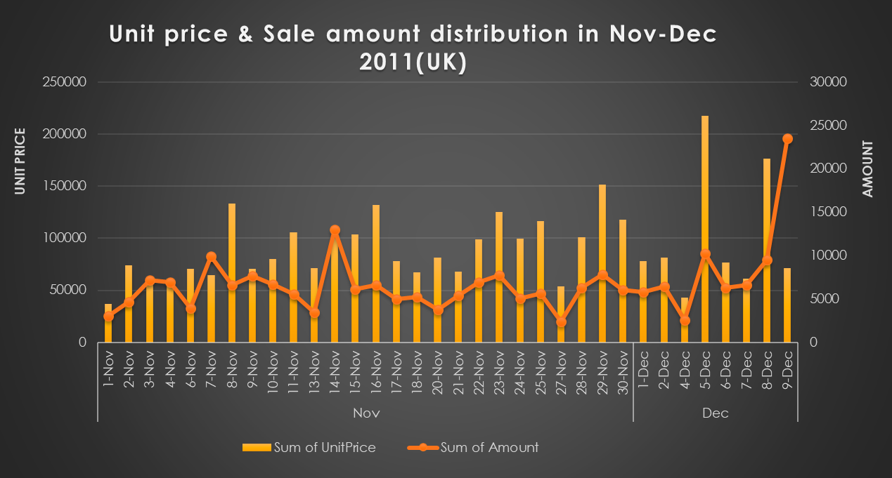
Sales amount and unit price distribution in UK
This graph how sales amount is varying in month of Nov-2011 and Dec-2011 in UK
Yellow color(bar) shows sum of unit price while orange color(line) shows sum of sales amount

Slide 18
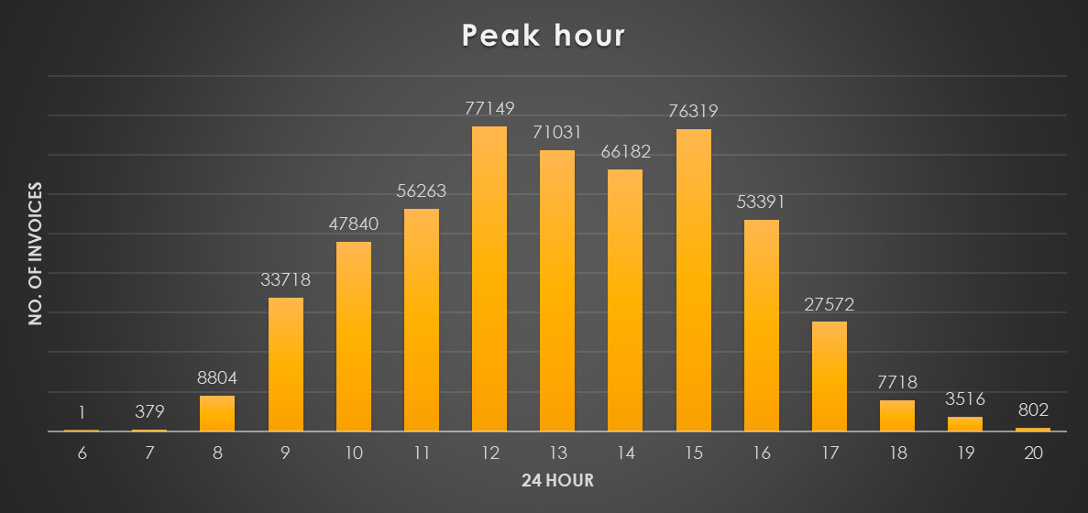
Peak Hours
These shows maximum customers buys in between 11:00 am to 4:00 pm
Company should arrange sufficient staff to deal with customer in these peak hours

Slide 19
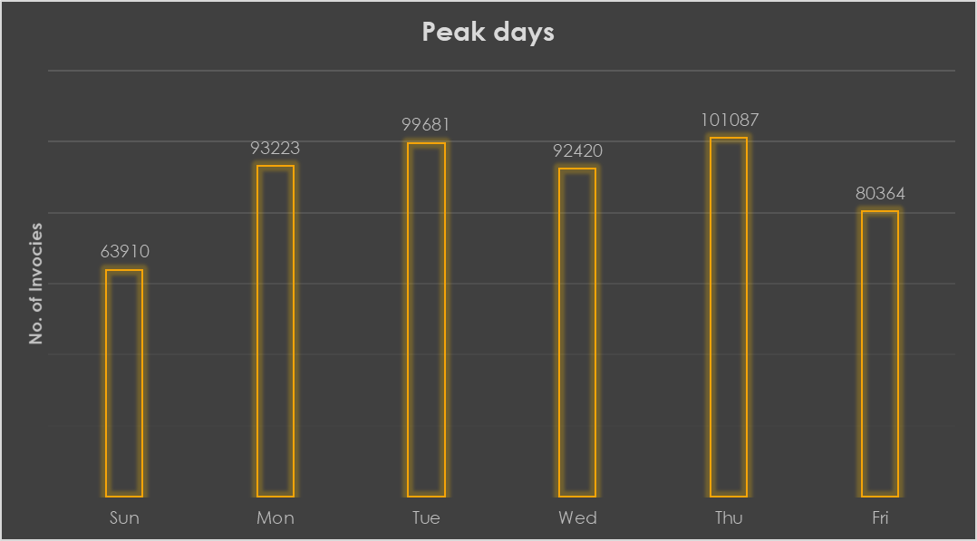
Peak Days
These show company provide service all the seven days
Maximum rush is on Tuesday and Thursday
Less rush is on Sunday

Slide 20
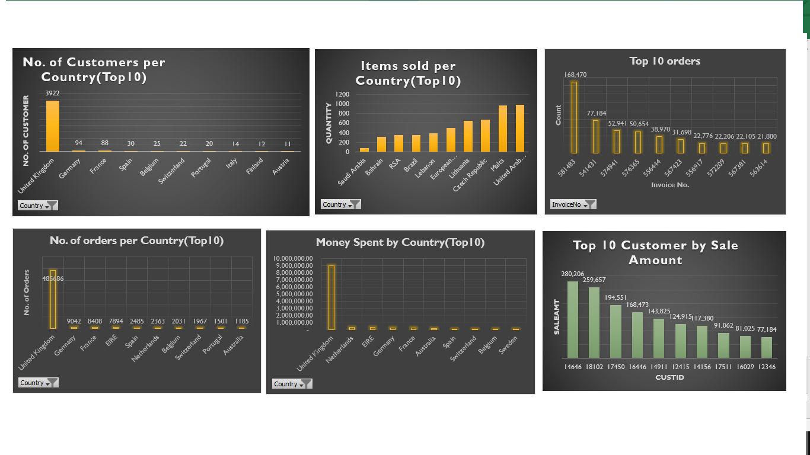
Dashboard 1

Slide 21
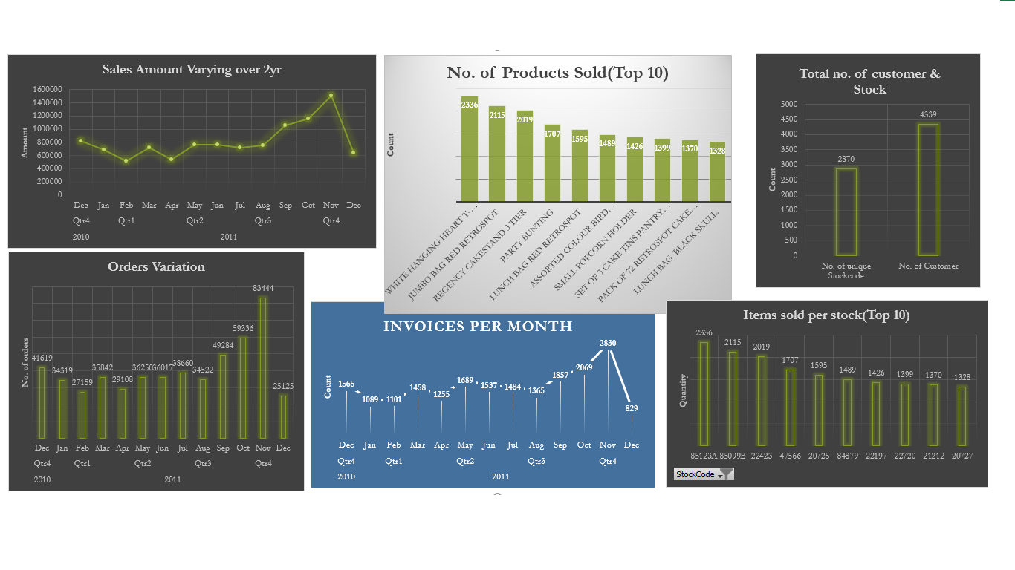
Dashboard 2

Slide 22
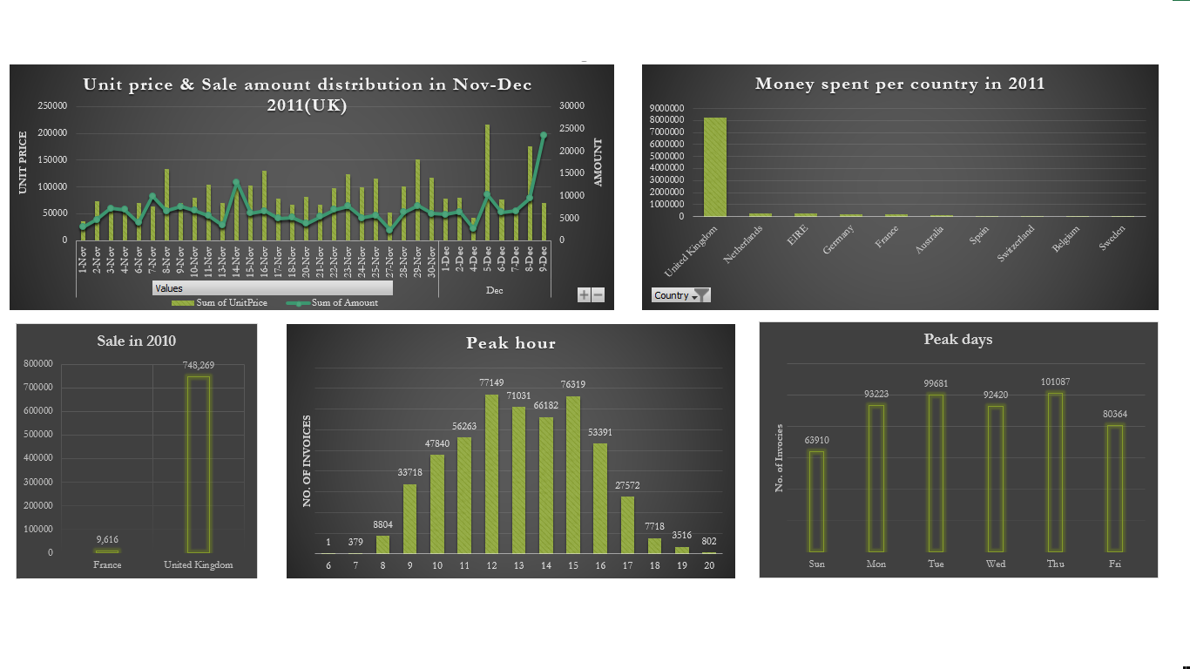
Dashboard 3

Slide 23
Important Insights
Company get maximum in all terms from UK(since it is UK based company)
To grow, company should focus on expanding their business in more extent in the next highest countries like Germany, Netherlands, France, EIRE, Spain. These countries will be future market for the company
To provide good service to the customer, company should effectively manage peak hours which is in between 11:00 am to 4:00 pm
Company should maintain good relationship with top customers which purchases in maximum amount

Slide 24
Conclusion
Highest no. of orders, money spent, no. of customers are from UK
Countries which receive highest no. of orders excluding UK are Germany, France, EIRE, Spain
Countries of customer who spent highest no. of money are UK, Netherlands, EIRE, Germany, France
Highest sale occurred in Nov-2011
Peaks hours are from 11:00 am to 4:00 pm and peak days increases from Monday to Thursday and decreases afterwards

Slide 25
Thank You

